Slide 1

RES - Exploring Resource Exploitation Space
Andrei Calin Cadar
Summer Intern

Slide 2
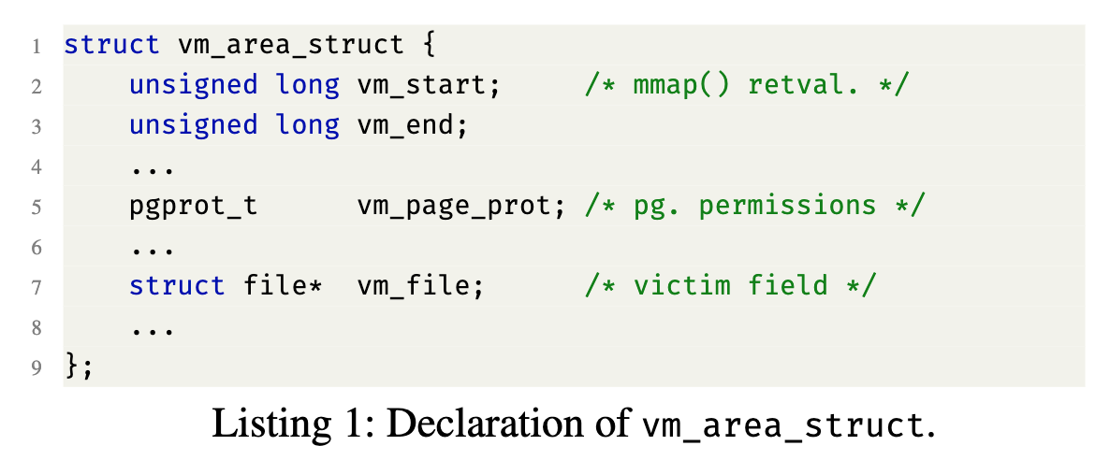
Introduction
Previous work, Scavy, identified memory targets for kernel exploitation.
For example, corrupting the vm_file field of vm_area_struct, one can access privileged file’s content (e.g., /etc/passwd file’s content).

Slide 3



Introduction
The goal of my project is to identify these sensitive files, the sensitive fields inside them and what to overwrite them with to cause a privilege escalation.
We know that server applications have a lot of these files so the targets will be the files of the most popular applications.

Slide 4
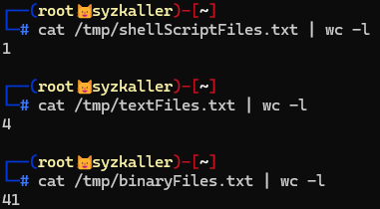
Collecting kernel logs
I used kprobe to collect kernel logs in order to find which files are used by the application.
Going through the files we can see three main categories:
Shell Scripts
Text Files
Binaries

Slide 5
Collecting kernel logs
Shell scripts are an easy way to priv-esc
Modifying binary opcodes was to complex for the internship’s timeframe
Our work will focus on text files (configuration files)

Slide 6
Parser
We needed to parse the files line by line.
I decided to use regex expressions to indicate the type of the field to fuzz it using appropriate values that would not result in a syntax error.
The types of fields that I defined are:
IP Address
IP Address:Port
Username@IP
Version
Link
Environment Variable
Keyword
Path
Number
String

Slide 7

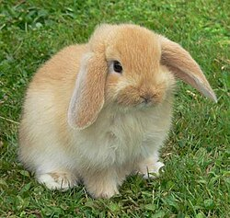
Fuzzing
Firstly I tried to fuzz with AFL (American Fuzzy Lop).
Google’s American Fuzzy Lop Real American Fuzzy Lop
AFL seemed like a good idea because it was already being used for quite a while and it could mutate the input based on received feedback.

Slide 8
Fuzzing
Unfortuantelly AFL was not suitable for us because AFL is very good at generating random bytes, so all values from 0x00 to 0xFF.
Just about 30% of ASCII characters might be bad for a configuration file. But if we generate a string of 5 characters the chance that it does not contain any bad character is just (1-0.3) ^ 5 = 16%.
I had to build my own random input generator.

Slide 9
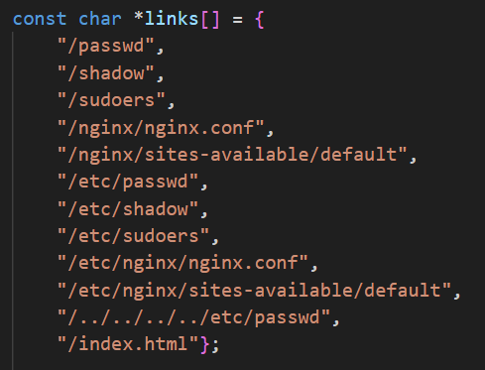
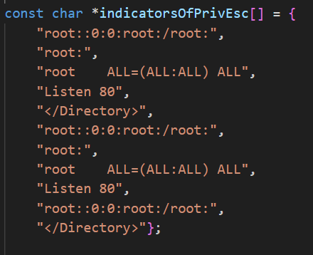
Testing
To test for priv-esc I created HTTP Request tests. These tests contain general sensitive resources for a Linux System, but also application specific resources.
For each resource I have an indicator of compromise string, that if found in the response, it means that we achieved privilege escalation.

Slide 10
Testing
As the results of the tests I have defined 5 possible outcomes:
OK
Not Found
Forbidden
Privilege Escalation (owned by root)
Privilege Escalation
Priv-esc owned by root means that the worker process is owned by root. (should never be this way)

Slide 11
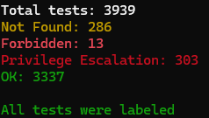
Results
Example of running the tool for Nginx
This took approximately 60 seconds to run. We have tried 450 values for the fields.
Our performance limits then are around testing 10 values per second

Slide 12
Things that I have tried
HTTP requests using socket() instead of curl. It was 64% slower, found out that curl is heavily optimized.
Adding code coverage as a metric to be used in the feedback mechanism of our fuzzer.
Lcov: Application needs to exit gracefully
Ftrace(syscall heatmap): Does not get well with kprobe

Slide 13
Talk is cheap Show me the code
Linus Torvalds
Notes:
Citation slide

Slide 14
Name: Andrei Calin Cadar
Email: cadarandrei2370@yahoo.com

